Slide 1




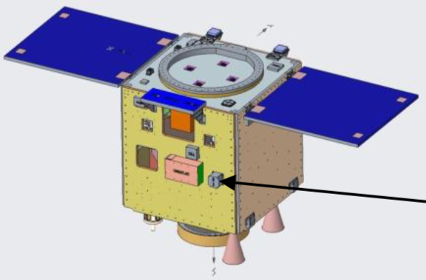
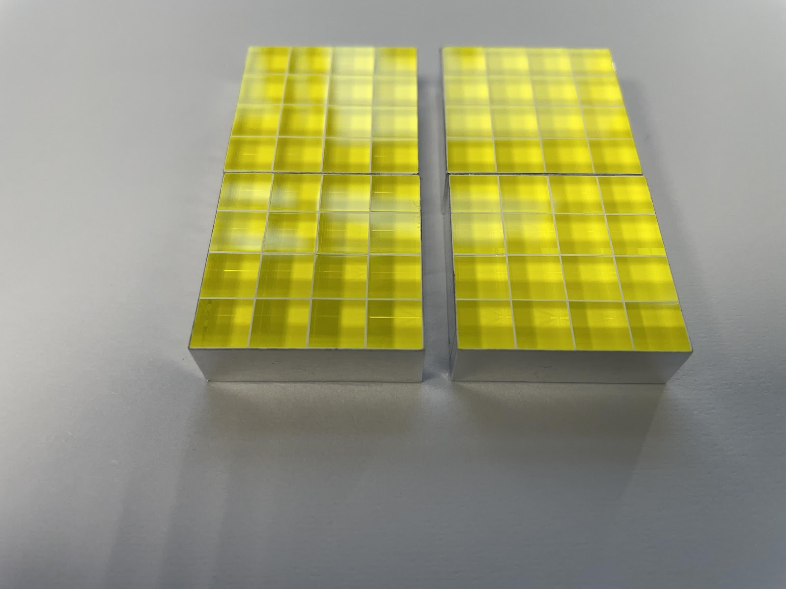
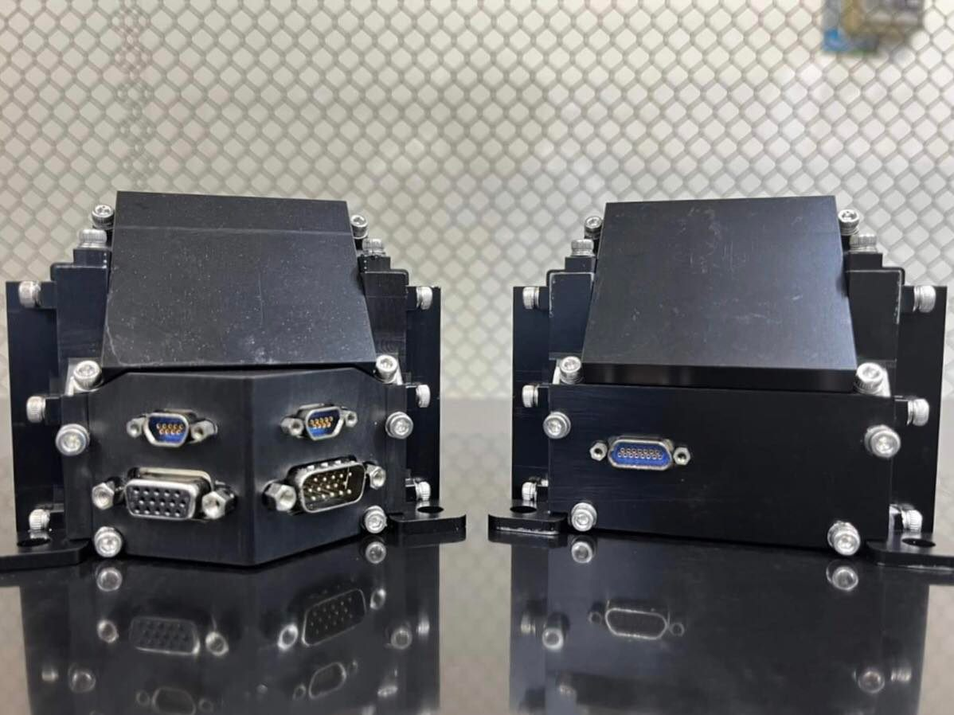
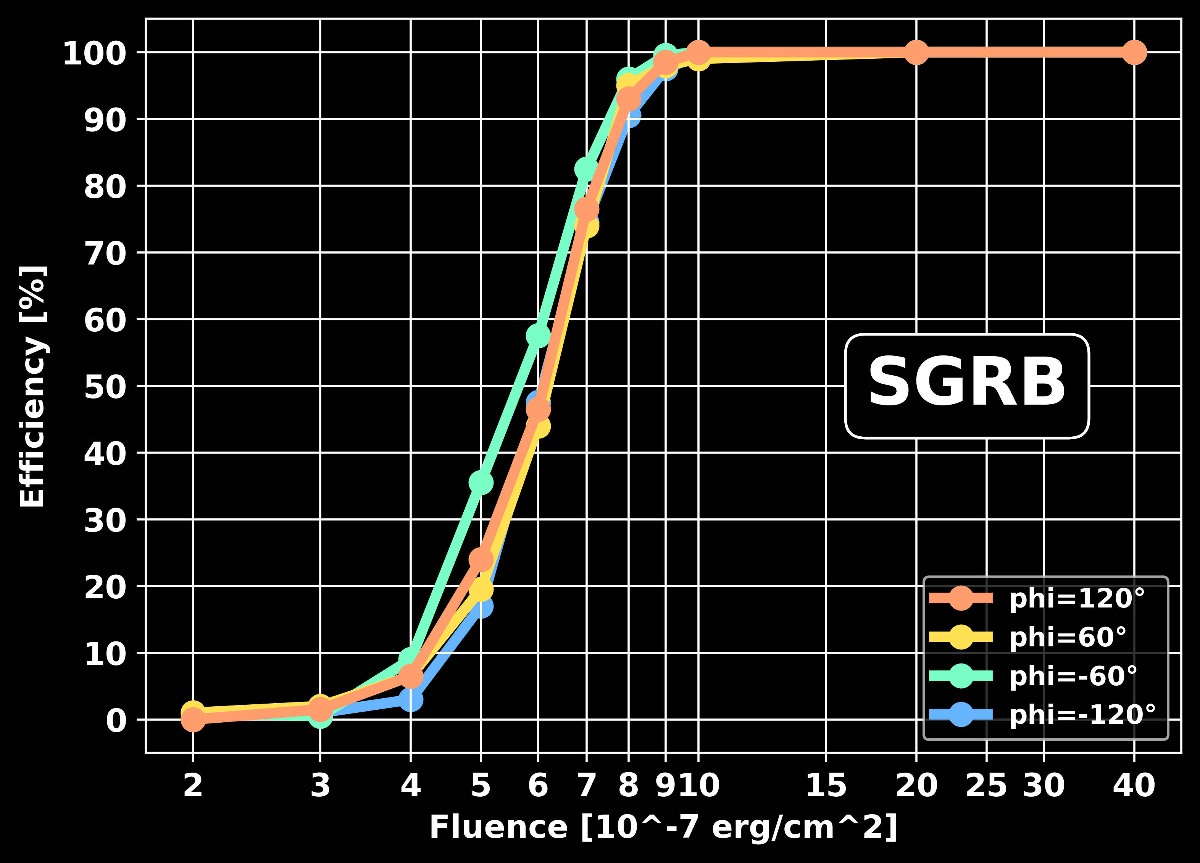
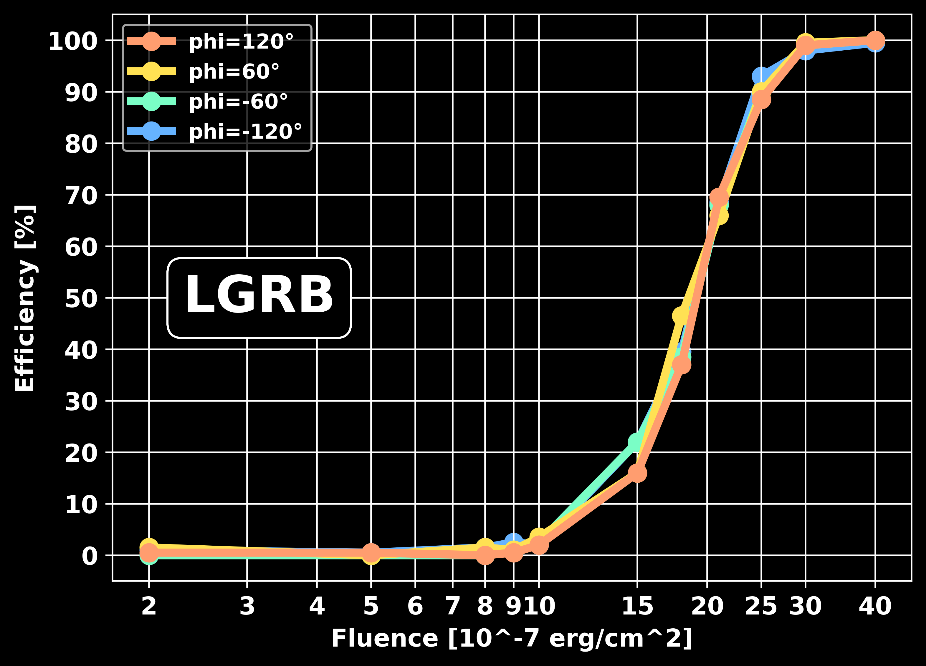
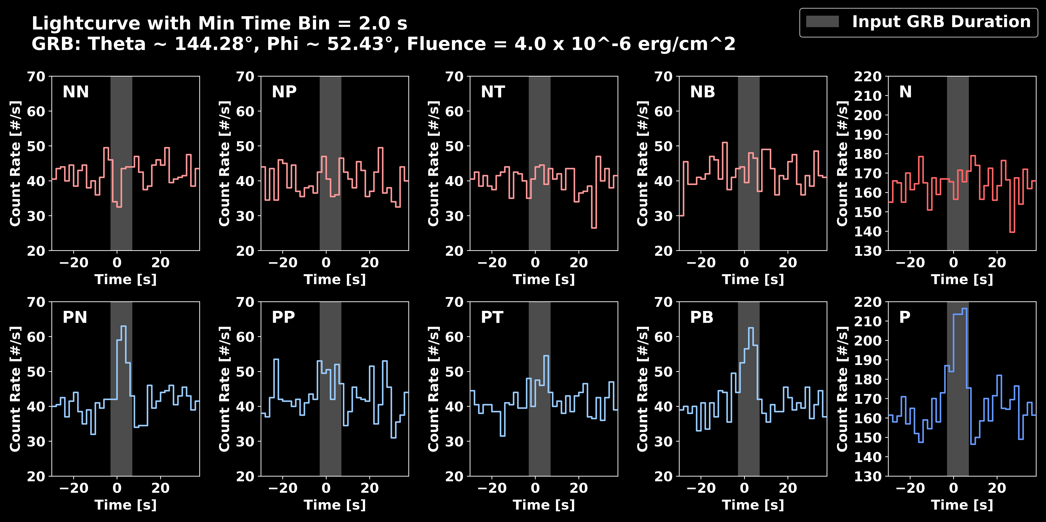
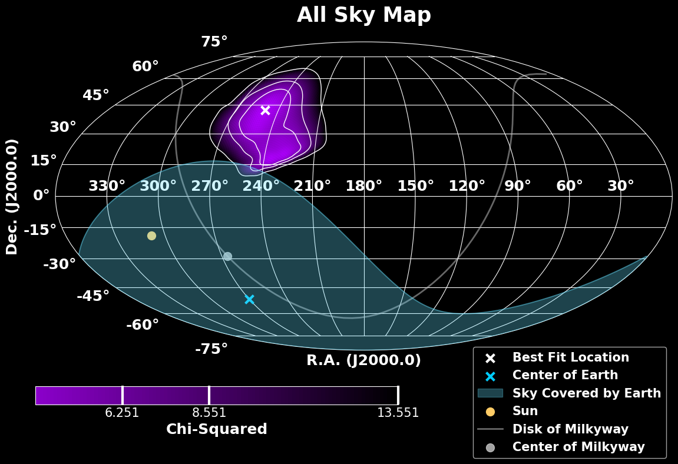
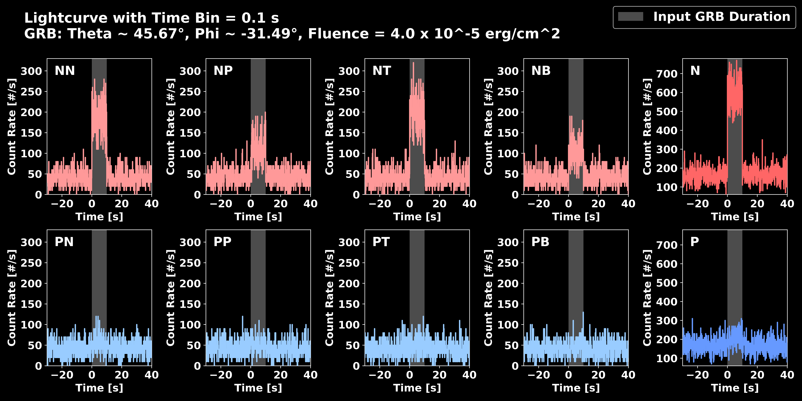
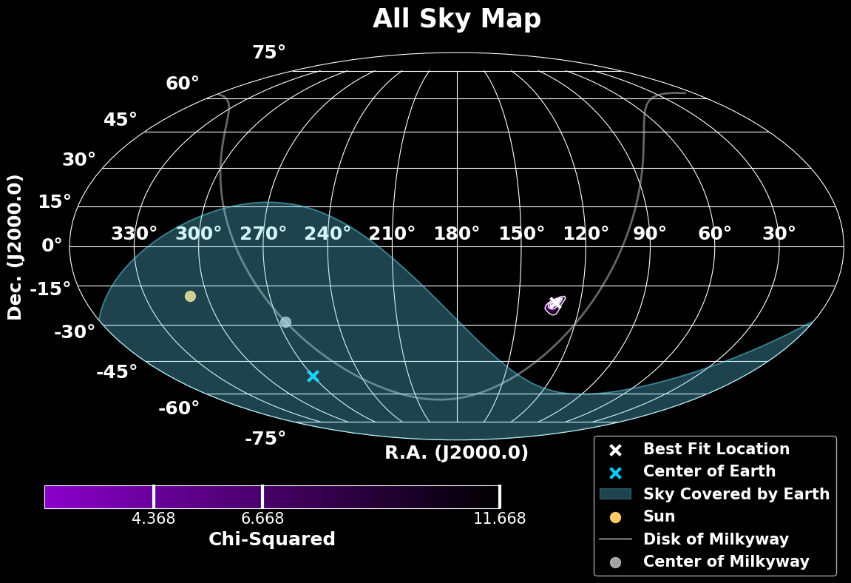

GRB Detection Efficiency and Localization Capability of the
Gamma-ray Transients Monitor (GTM) on board Formosat-8B
Chien-You Huang(1), Shun-Chia Yang(2), Hsiang-Kuang Chang(1,3,4), Chih-Hsun Lin(5), Che-Chih Tsao(6), Yung-Wei Chang(7), Yen-Fu Chen(6), Che-Yen Chu(3), Yun-Hsin Chung(3), An-Hsuan Feng(6), Jr-Yue Hsiang(3), Keng-Li Lai(6), Tsu-Hsuan Lin(1), Tze-Hsiang Su(1), Yun-Han Wang(5), Chien-Ying Yang(8)
Department of Physics, National Tsing Hua University, Hsinchu, Taiwan
Department of Electrical and Computer Engineering, National Yang Ming Chiao Tung University, Hsinchu, Taiwan
Institute of Astronomy, National Tsing Hua University, Hsinchu, Taiwan
Center for Informatics and Computation in Astronomy (CICA), National Tsing Hua University, Hsinchu, Taiwan
Institute of Physics, Academia Sinica, Taipei, Taiwan
Department of Power Mechanical Engineering, National Tsing Hua University, Hsinchu, Taiwan
Department of Physics, National Central University, Taoyuan, Taiwan
National Space Organization, National Applied Research Labs, Hsinchu, Taiwan
Abstract
The scientific purposes of GTM are to monitor Gamma-Ray Bursts (GRBs) and other bright gamma-ray transients in the energy range from 50 keV to 2 MeV. Base on detailed simulations, the 50% detection efficiency happens at the fluences (in the energy range from 10 keV to 1 MeV) of 2×10^(−6) erg/cm^2 and 6×10^(−7) erg/cm^2 for long and short GRBs, respectively. GTM is therefore expected to detect about 50 GRBs per year, according to the Fermi/GBM 10-year GRB-fluence distribution. For localization capability, the localization uncertainty at 3 sigma confidence level of long GRBs with the fluences of 4×10^(−5) erg/cm^2 and 4×10^(−6) erg/cm^2 are about 3 and 30 degrees, respectively.
Instrument Design
GTM is a secondary payload on board Formosat-8B (FS-8B), a Taiwanese remote-sensing satellite scheduled to launch in 2026. GTM consists of two identical modules located on two opposite sides of FS-8B. Each module has four sensor units facing different directions to cover half of the sky. The two modules will then cover the whole sky, including the direction occulted by the Earth. Each sensor unit is composed of a GAGG scintillator array (50 mm x 50 mm x 8 mm) to be readout by SiPM with 16 pixel-channels.
GAGG Scintillator
Formosat-8B
Master Module
Slave Module
Simulation Results
Artificial light curve
Interval: 1,000 s
LGRB: 10 s, soft (alpha=-1, Ep=300 keV) CPL spectra
SGRB: 0.5 s, hard (alpha=-0.5, Ep=500 keV) CPL spectra
Count rate bases on Chang et al., 2022, ASR, 69, 1249
Trigger algorithm
Time bin: 1, 2, 5 [ms, 10ms, 100ms & s] & 10 s and also their half-bin shift
If 8 individual sensors can’t find GRB trigger, 4 sensors on one module would be collected together to search
Threshold is defined as an average level making the false alarm probability of Poisson distribution of background level < 1e-3
To derive the detection efficiency, 10,000 # artificial light curves with a certain fluence from a certain direction are fed into the trigger algorithm.
For the localization, a simu-lated table was built up by separating all sky to become 1,600 directions and enlar-ging them to 41,168 direc-tions with Fibonacci sphere. Therefore, the real observed data can be compared with the simulated table by the Chi-squared fitting. Finally, the most possible direction and the confidence level will be reported.
✬
Reference
✬
✬
✬
✬

